Slide 1
Ideal location for Opening an Asian Supermarket in the Toronto
Capstone Project – Noah W.

Slide 2
Business Introduction
Opening up a Asian supermarket in Toronto
Supermarket is planning to cover various Asian products including frozen foods, grocery, meat, produce, seafood, snacks, liquor, dairy, etc.
An ideal location is one of the most important factor for a consumer-oriented retail business to be success.
Requiring an analysis that helps to find out the best location for this supermarket
The ideal location should avoid too many competitors surrounding and close to potential buyers if possible.

Slide 3
Data and Data Acquisition
For this analysis, there are two datasets are being used:
Toronto neighborhood data
Foursquare location data
The neighborhood data in Toronto is obtained from Wikipedia: "List of postal codes of Canada: M”.
Foursquare location data is calling by using the coordinates which are explored from the dataset of Toronto neighborhood in Python.
The Foursquare API returns venues with necessary information (i.e. information regarding the existing food supermarkets in Toronto) for analysis and supports the final recommendation.

Slide 4
Methodology
Loading the list from Wikipedia page regarding the Toronto
Cleaning data
Using geocoder to capture the coordinates for neighborhoods accordingly.
Calling the venue and venue category from the Foursquare API
Filtering venues categories to the relevant categories only by string the key words
Constructing data frame to present the mean of frequency of occurrence of each relevant categories based on each Neighborhoods.
Applying K means clustering method according to the values of top venues and plotting the map accordingly.

Slide 5
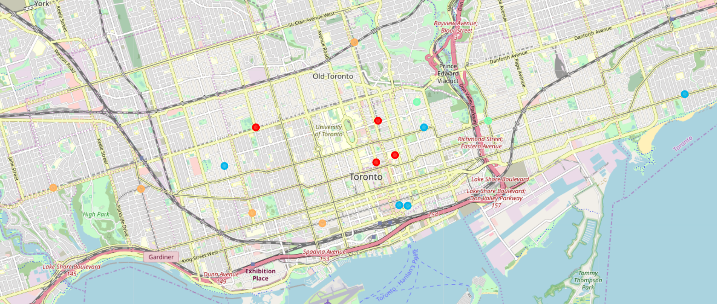
Result
Cluster 0: Red Points – Areas with restaurants that serving many Asian element foods (ex: Japanese, Chinese, Thai, etc.) and has bus lines/stops surrounding. But some small businesses like bakery and liquor stores nearby.
Cluster 1: Purple Points – Areas with dessert shops, deli and farmers markets and with a few of Asian food restaurants. But since the location is far from the main business district, it’s not included in the above snapshot and thus will not be considered further.
Cluster 2: Blue Points – Areas are consist of many food related businesses such as bakery, pastry shop, and various makers. However, many Japanese restaurants are located in these areas, and they has convenient transportation.
Cluster 3: Green Points – Areas with many Asian restaurants. But there are markets around there. Bus line across these areas.
Cluster 4: Orange Points – Areas with many shops and markets. Some Asian restaurants exists and bus line across these areas.

Slide 6
Discussion
An ideal location for a retail business should avoid too many competitors nearby, and it should close to the properties that may benefit to the business.
The location should far from other competitors such as markets. If there is no such spot available, look for a place with fewer competitors are surrounding.
The location should be close to Asian food restaurants as they may become potential buyers in the future. Bus lines/stops may be another element that needs to be considered.
Older people may choose to take the bus instead of driving to a destination. So having more convenient transportation, more customers may come to the supermarket.
Therefore, after considering the above mentioned factors and gathering the results, it’s recommend to pick Central Bay Street for opening up the first supermarket as there are many Asian restaurants but only has few markets and shops as competitor. Bus lines/stops are around the street.

Slide 7
Conclusion
This report provides the analysis on the neighborhoods in Toronto and recommends a location for opening up an Asian supermarket based on that.
This report provides proof for the recommendation which should address the most questions or concerns from the management team of the Asian food wholesale company regarding the location selection, and thus build a bridge toward success on their first retail supermarket.

